Slide 1

Lifting The Hood On ML

Slide 2
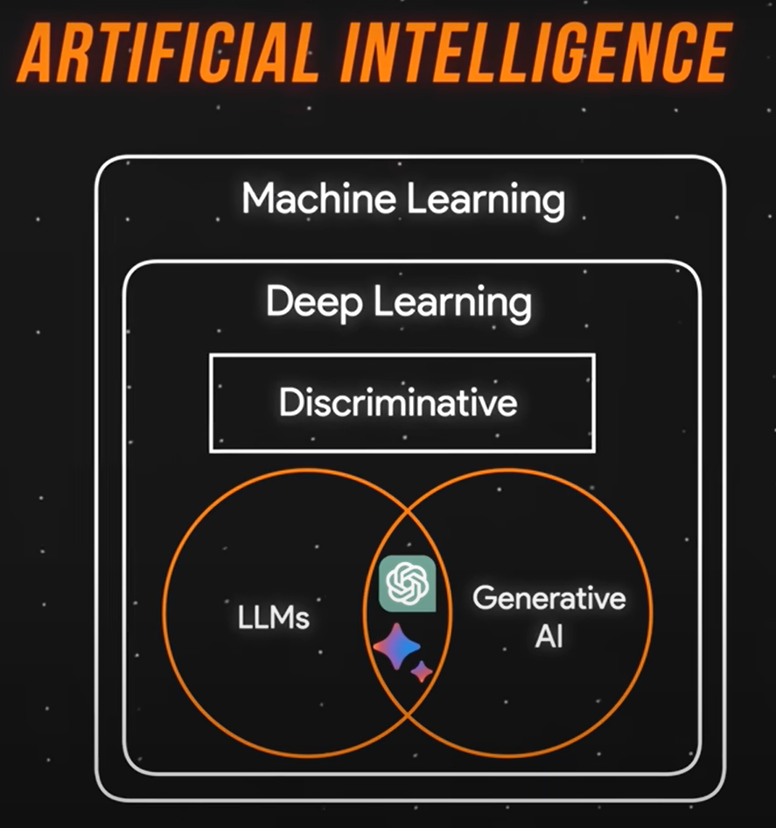
What is Machine Learning
What - Machine learning is a subset of artificial intelligence that enables systems to learn from data and improve over time without being explicitly programmed.
How - By giving the computer lots of data to look at. The system then tries to find patterns and learn from them. As it sees more examples, it gets better at making predictions or decisions.

Slide 3

Use Case – Credit Card Fraud Detection
The data set includes credit card transactions made by European cardholders over a period of two days
Out of a total of 2,84,807 transactions, 492 were fraudulent.
This data set is highly unbalanced, with the positive class (frauds) accounting for 0.172% of the total transactions.
The data set has also been modified to maintain confidentiality.
Apart from ‘time’ and ‘amount’, all the other features (V1, V2, V3, up to V28) are obtained after modification
The feature 'class' represents class labelling, and it takes the value of 1 in cases of fraud and 0 in others.

Slide 4
Exploring Algorithms
Linear Regression: Predicting numerical values (e.g., stock prices)
Logistic Regression: Binary classification (e.g., loan approval)
Decision Trees: Rule-based predictions (e.g., investment strategies)
Random Forests: Ensemble learning for complex predictions (e.g., customer churn in a telecommunications company)
Support Vector Machines: Finds the best boundary to separate classes (e.g., detecting fraudulent credit card transactions.)

Slide 5
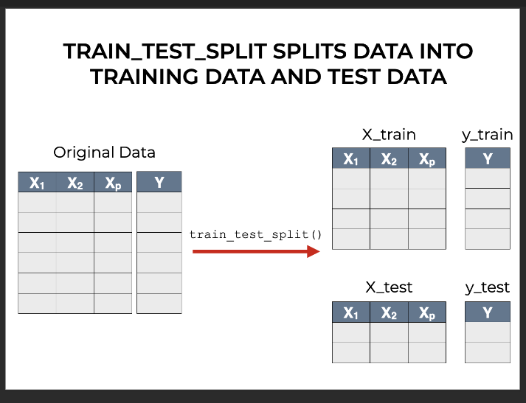
Data Preparation and Model Training Workflow
Step 1: Separating output(y) from input(x) to ensure clear distinction between input and output
Step 2: Splitting the data and output into two sets – train and test sets

Slide 6

Performance metrics and Model Evaluation
Accuracy: It is the percentage of predictions that the model got right out of all the predictions it made.
Accuracy= Correct Predictions / Total Predictions
Precision: Tells you how many of the positive predictions made by the model were actually correct. It’s about the quality of the positive predictions.
Precision= True Positives​ /True Positives + False Positives
Recall : Measures how well the model is at identifying all the actual positive instances. It’s about not missing any positives
Recall=True Positives​/ True Positives + False Negatives
AUC measures the overall ability of the model to distinguish between classes (positive vs. negative) across all possible thresholds. A higher AUC means the model is better at separating the classes

Slide 7

Cross Validation and Fine Tuning
RepeatedKFold: Shuffling the data set multiple times to train the model to cover the maximum training and testing operations
StratifiedKFold: Folds are made while preserving the percentage of samples for each class.
Fine Tuning: Oversampling methods such as SMOTE and ADASYN are used.

Slide 8

Transparency and Accountability
ensure the data meets ethical standards and is free from biases, as you have full visibility and control over the data pipeline.
Customizable and Simple Architectures
The model’s decisions are easier to trace and understand because the logic behind them is less complex.
Simpler models allow for direct investigation into how and why a decision was made, enabling accountability.
Control Over Training Data and Sources
Documenting and tracking the origins and transformations of the data used in training is possible
One can ensure the data meets ethical standards and is free from biases, as you have full visibility and control over the data pipeline.

Slide 9
Risks and Limitations
Data Quality : Poor data leads to unreliable results, which can significantly impact decision-making and lead to erroneous conclusions.
Bias in Data Models : Bias in training data can amplify stereotypes, leading to unfair or unethical predictions, especially in sensitive areas like hiring, lending, or law enforcement.
Over-Reliance on ML : Automating critical processes without validating model outputs can reduce accountability and lead to mistakes in applications like healthcare, finance, and law.
Regulatory Compliance : Failure to comply with regulations can result in legal penalties, loss of trust, and damage to reputation.
Lack of Explainability :Many ML models, especially deep learning, are often viewed as “black boxes,” meaning their decision-making process is difficult to understand. The weights and inner workings of the model might not be transparent.

Slide 10
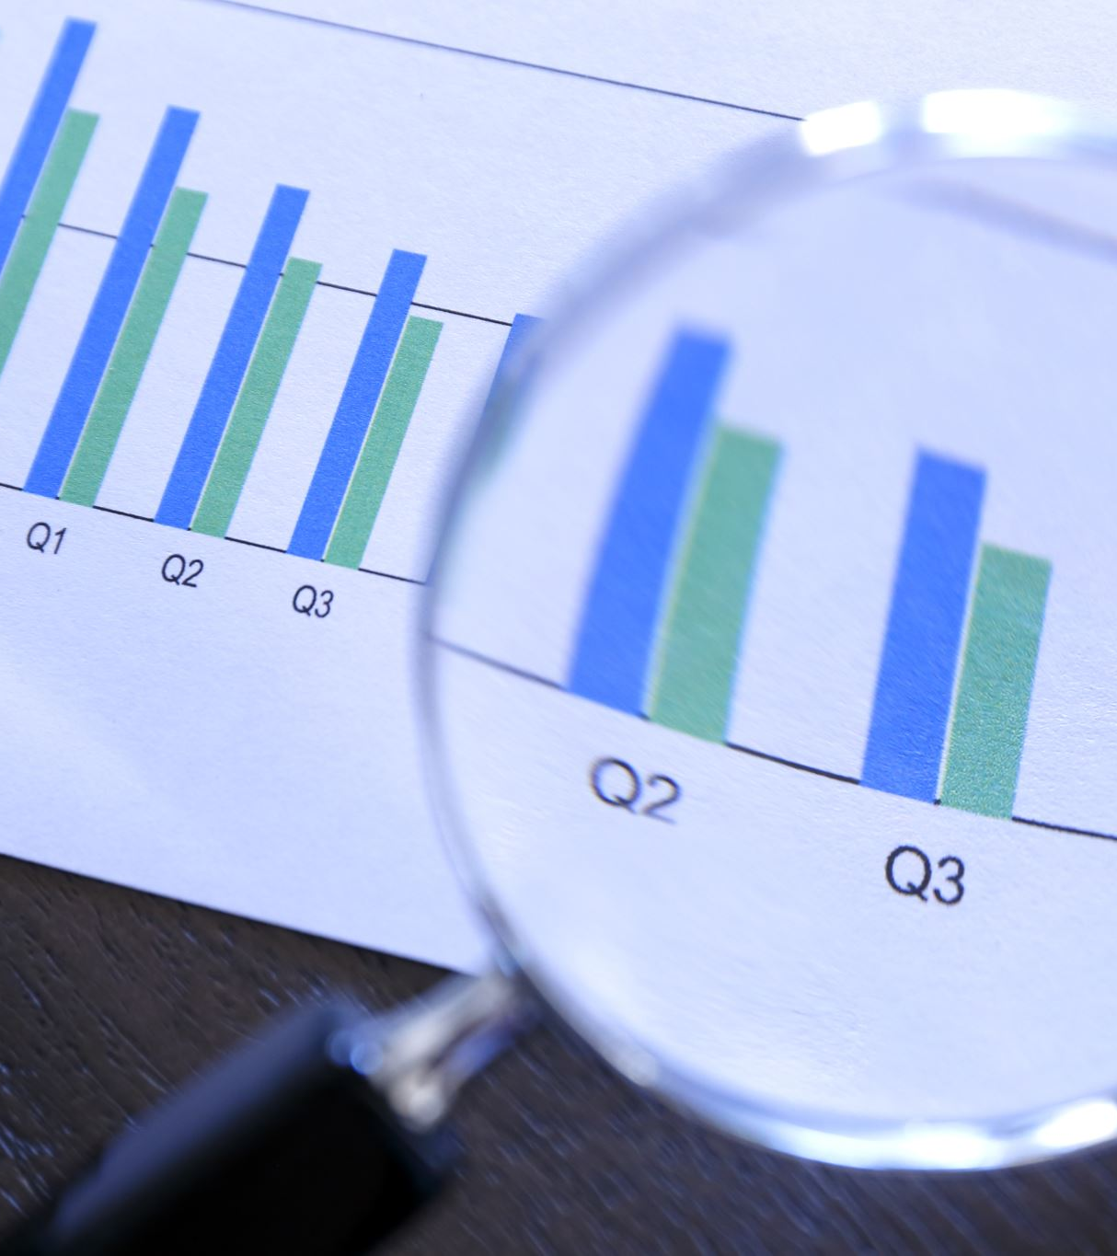
Advanced ML Techniques
Deep Learning: Deep learning, particularly neural networks, has become increasingly popular for complex financial modeling due to its ability to handle large amounts of data and capture non-linear relationships.
Natural Language Processing: NLP techniques are used to extract valuable insights from unstructured text data in financial news, reports, and social media.
Time Series Analysis: Time series analysis is crucial for understanding and predicting trends over time.

